Slide 1
Attachment Wizard CT v.1.21.10.4
Martin Reisinger, presenter
May 17, 2021

Slide 2
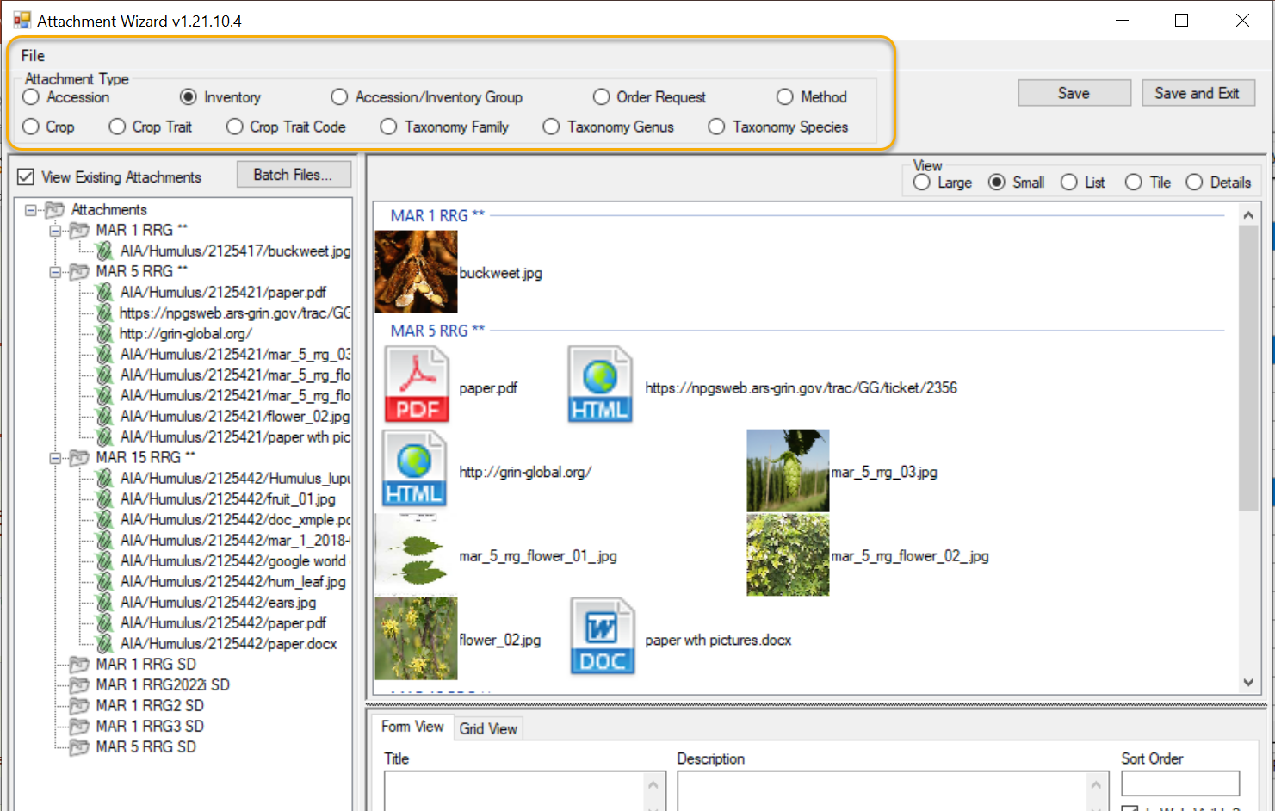
What’s New?

Slide 3
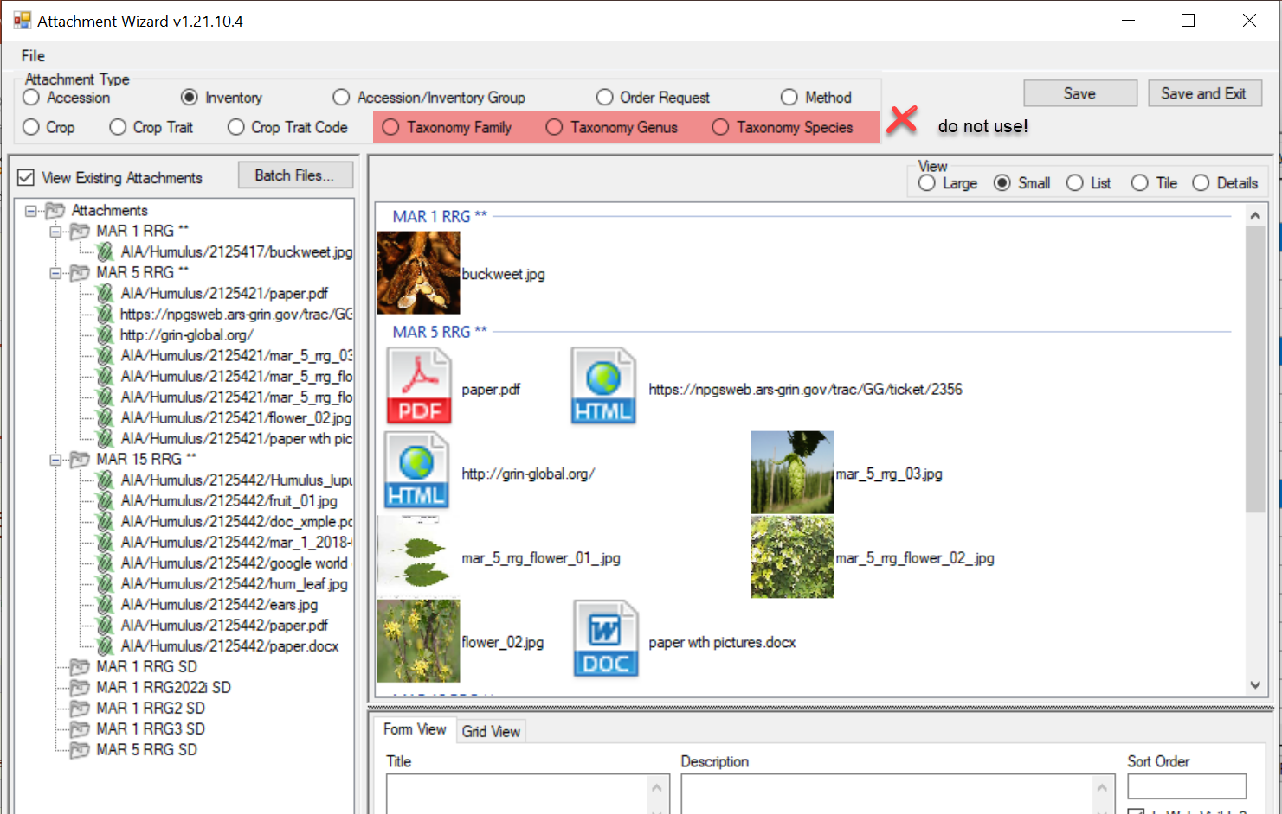
Do not use Taxonomy (NPGS)

Slide 4
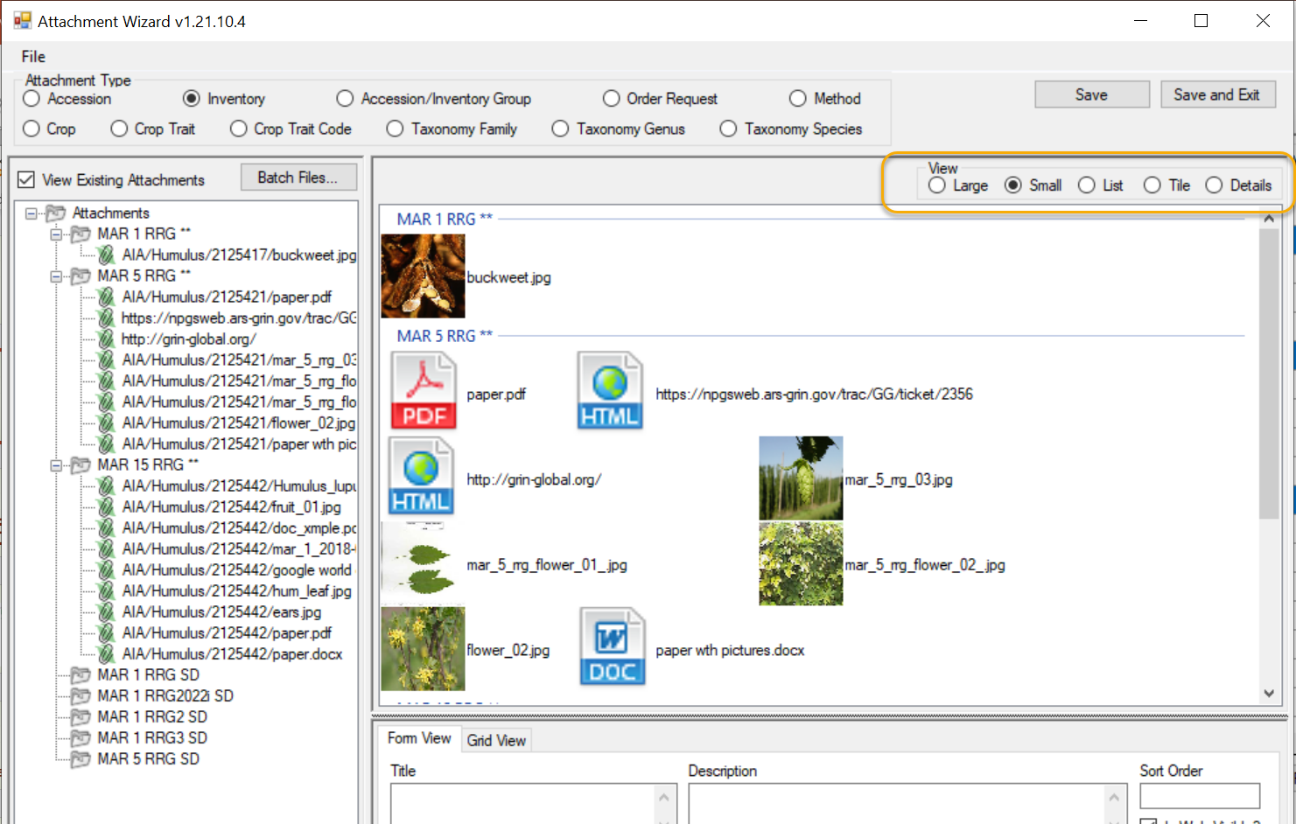
What’s New?
View sizes option

Slide 5
Folder & File Naming Conventions – Important!
The file name or the folder name of the folder containing the files to be attached
… is critically important, especially when using the Batch Method

Slide 6
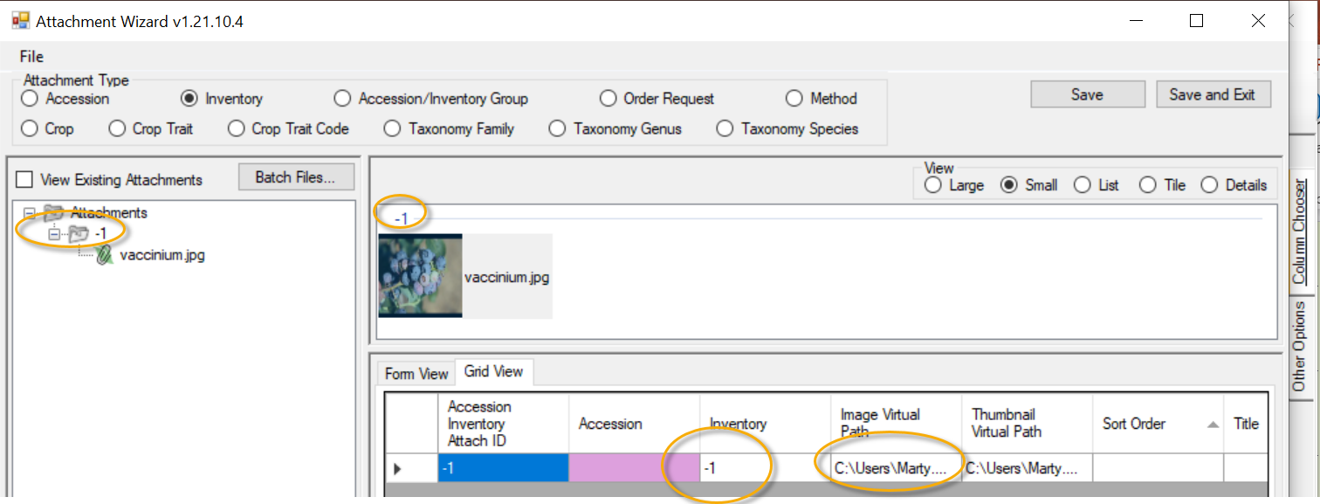
Stop!

Slide 7
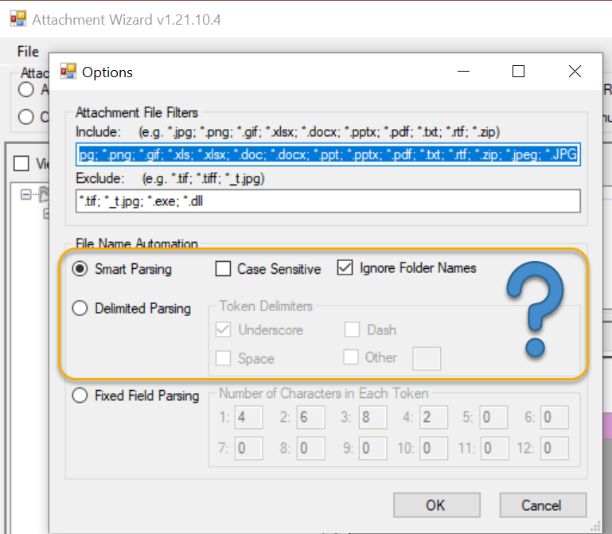
Review Options

Slide 8
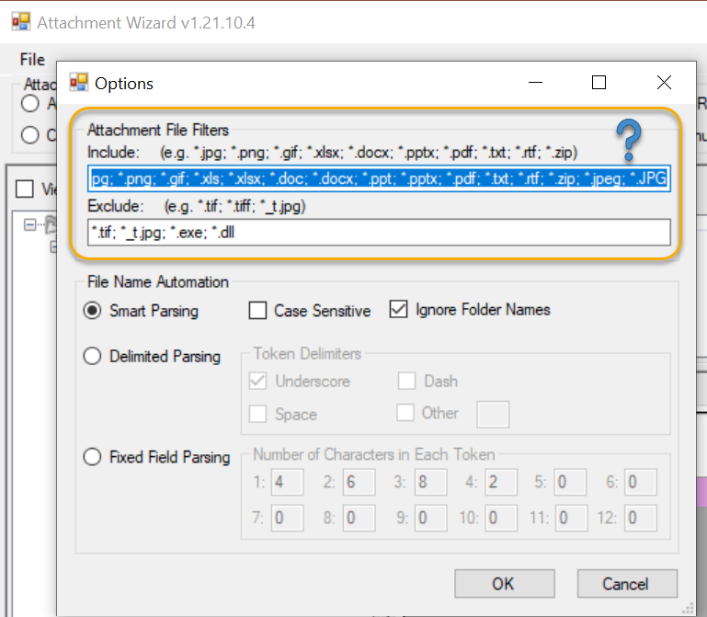
Review Options
Add extension type:
; *.JPG

Slide 9
3 basic methods for attaching files
Drag files directly from Windows Explorer to an item in a CT list
Drag files into the Attachment Wizard (from Windows Explorer to an item in wizard)
Use the wizard’s Batch Files method (opens a Windows Explorer window)

Slide 10
Let’s doit

Slide 11
Demos

Slide 12
References
Curator Tool Release Notes
Attachment Wizard Guide
GG Project User Documentation page
Curator Tool Installation page
NPGS News & Training page (has ZOOM link and details)

